Slide 1
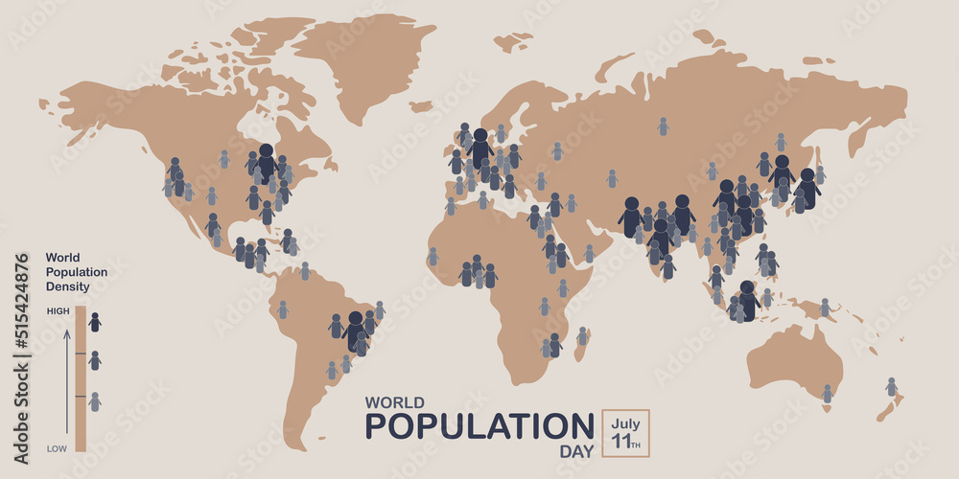
World Population : A Global Perspective
Presented by Group 3

Slide 2
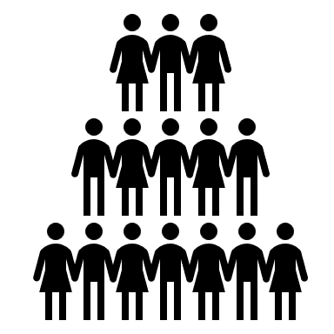
Overview
World Population Day, or International Population Day, is celebrated on July 11. It aims to raise awareness about global population issues and educate people about family planning, gender equality, and reproductive health. This day was established by the United Nations in 1989 and commemorates the “Day of Five Billion” when the world’s population crossed the 5 billion mark.
8
Billion

Slide 3
As per data, India ranks highest in world population for the last two years, 2023 and 2024 with an increase of 130,92,189 in 2024, whereas New Zealand is the lowest in the world population ranking.
Demography is useful for governments and private businesses as a means of analyzing and predicting social, cultural, and economic trends related to population.

Slide 4
Total global population currently stands at 8 Billion, with China leading with a population of 1.42 Billion people.

Slide 5
The geographic region with the largest population in 2023 was Asia with a total population of 4.7 Billion people, closely followed by Africa with a population of 1.4 Billion.
Top ranker Bangladesh is 386 times as dense as the lowest-ranked Australia.

Slide 6
